Slide 1
Software Engineering (CSC205) gg BSCS/BS(SE)-III
Lecture 4

Slide 2

Words of Wisdom
The problem is that we sow different than what we expect to reap. You will reap what you sow.
If anyone does a righteous deed it ensures to the benefit of his own soul; if he does evil it works against (His own soul). In the end will ye all be brought back to your Lord. Al-Quran (45:15)

Slide 3
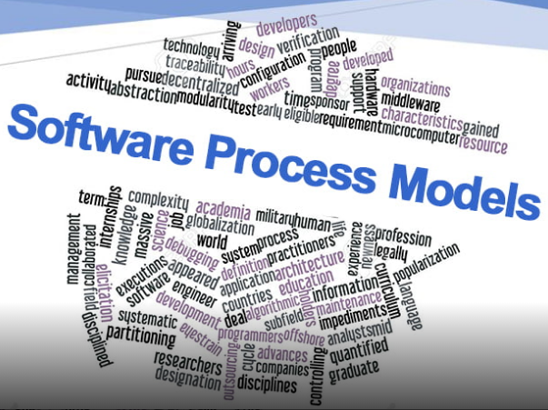
Topics
Process Models
Rapid Application Development (RAD) Model
Prototyping
Spiral Model

Slide 4
The RAD Model
Rapid Application Development - James Martin (1991)
An incremental software development process that emphasizes on extremely short development cycle.
Rapid development is achieved by using a component-based construction approach.
Used primarily for information systems applications.
RAD projects are typically staffed with small integrated teams comprised of developers and end users.

Slide 5
The RAD Model…

Slide 6
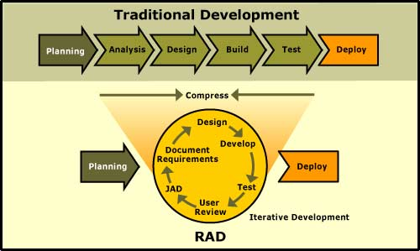
The RAD Model…

Slide 7
The RAD Model…
The time constraints imposed on a RAD project demand “Scalable Scope”.
If a business application can be modularized in a way that enables each major function to be completed in less than three months, it is a candidate for RAD.
Each major function can be addresses by a separate RAD team and then integrated to form a whole.
When it works
The application will be run standalone.
Performance and reliability is not critical.
System can be split into several independent modules.
The required technology is more than a year old.

Slide 8
The RAD Model: Drawbacks
For large, but scalable projects, RAD requires sufficient human resources to create the right number of RAD teams.
If developers and customers are not committed to rapid-fire activities necessary to complete the system in a much abbreviated (i.e., shortened) time frame, RAD projects will fail.
If a system can’t be properly modularized, building the components necessary for RAD will be problematic.
RAD may not be appropriate when technical risks are high.

Slide 9
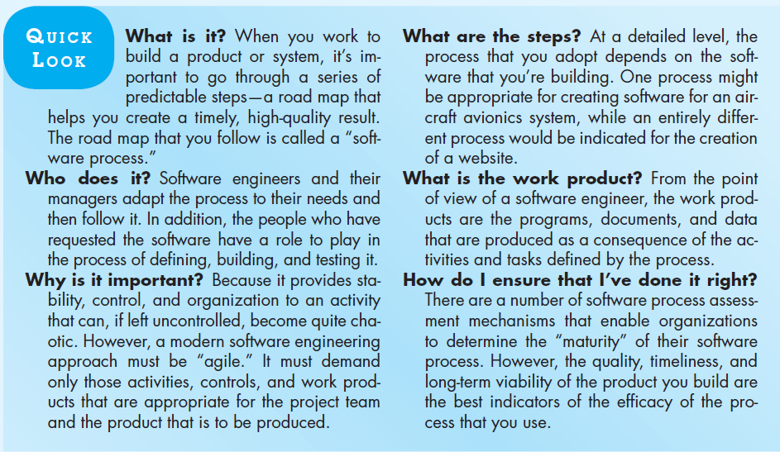

Slide 10
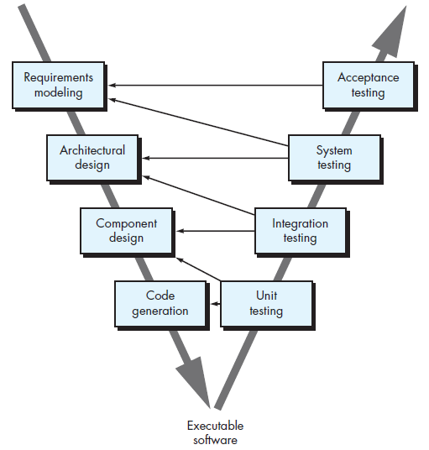
The V-Model

Slide 11
Evolutionary Models
Software system evolves over time as requirements often change as development proceeds. Thus, a straight line to a complete end product is not possible. However, a limited version must be delivered to meet competitive pressure.
Usually a set of core product or system requirements is well understood, but the details and extension have yet to be defined.
You need a process model that has been explicitly designed to accommodate a product that evolved over time.
It is iterative that enables you to develop increasingly more complete version of the software.
Two types are introduced, namely Prototyping and Spiral models.

Slide 12
Evolutionary Models: Prototyping
When to use: Customer defines a set of general objectives but does not identify detailed requirements for functions and features. Or Developer may be unsure of the efficiency of an algorithm, the form that human computer interaction should take.
What step: Begins with communication by meeting with stakeholders to define the objective, identify whatever requirements are known, outline areas where further definition is mandatory. A quick plan for prototyping and modeling (quick design) occur. Quick design focuses on a representation of those aspects the software that will be visible to end users. ( interface and output). Design leads to the construction of a prototype which will be deployed and evaluated. Stakeholder’s comments will be used to refine requirements.
Both stakeholders and software engineers like the prototyping paradigm. Users get a feel for the actual system, and developers get to build something immediately. However, engineers may make compromises in order to get a prototype working quickly. The less-than-ideal choice may be adopted forever after you get used to it.

Slide 13
Evolutionary Models: Prototyping
Quick
plan
communication
Modeling
Quick design
Construction
of prototype
Deployment
delivery &
feedback
Construction
of prototype

Slide 14
The Spiral Model

Slide 15

The Spiral Model
Originally proposed by Barry Boehm (1986)
A heavy-weight, plan-driven, highly-structured approach for large projects.
Especially designed for those with higher chances of failure.
Process is represented as a spiral rather than as a sequence of activities with backtracking.
Combines iterative model, emphasizes risk assessment, customer participation, prototyping, and more
No fixed phases such as specification or design - loops in the spiral are chosen depending on what is required.
Risks are explicitly assessed and resolved throughout the process.

Slide 16
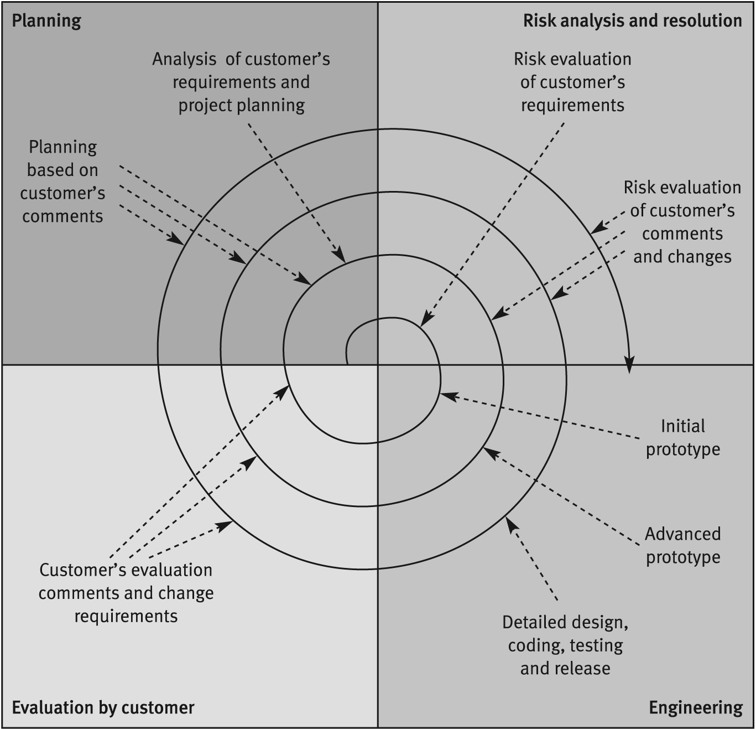
The Spiral Model…
Can see each spiral
includes:
Planning
Risk Analysis / Resolution
Engineering activities
(design, code, test…)
Customer Evaluation
(errors, changes, new
requirements…)

Slide 17
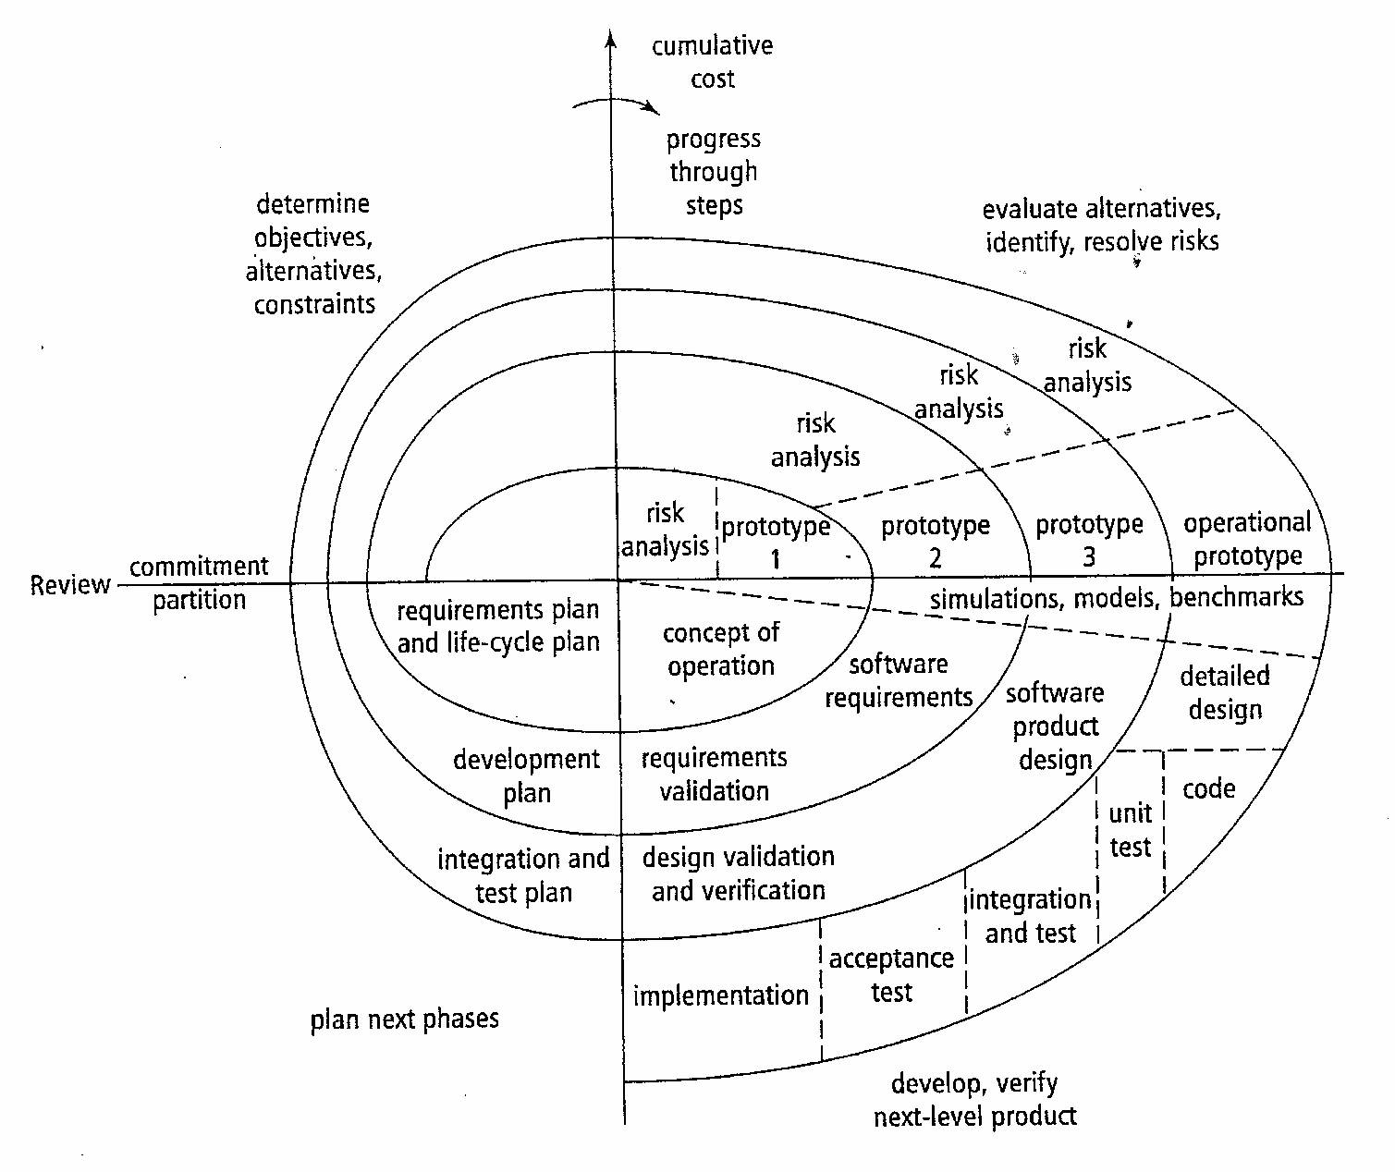
Details of Spiral SDLC

Slide 18
Another View of Spiral Model
Risk Assessment
Req. Change
Requirements
Risk Assessment
Verify
Design
Risk Assessment
Verify
Implementation
Test
Adds a Risk Analysis step to each phase.
Operations
Retirement

Slide 19
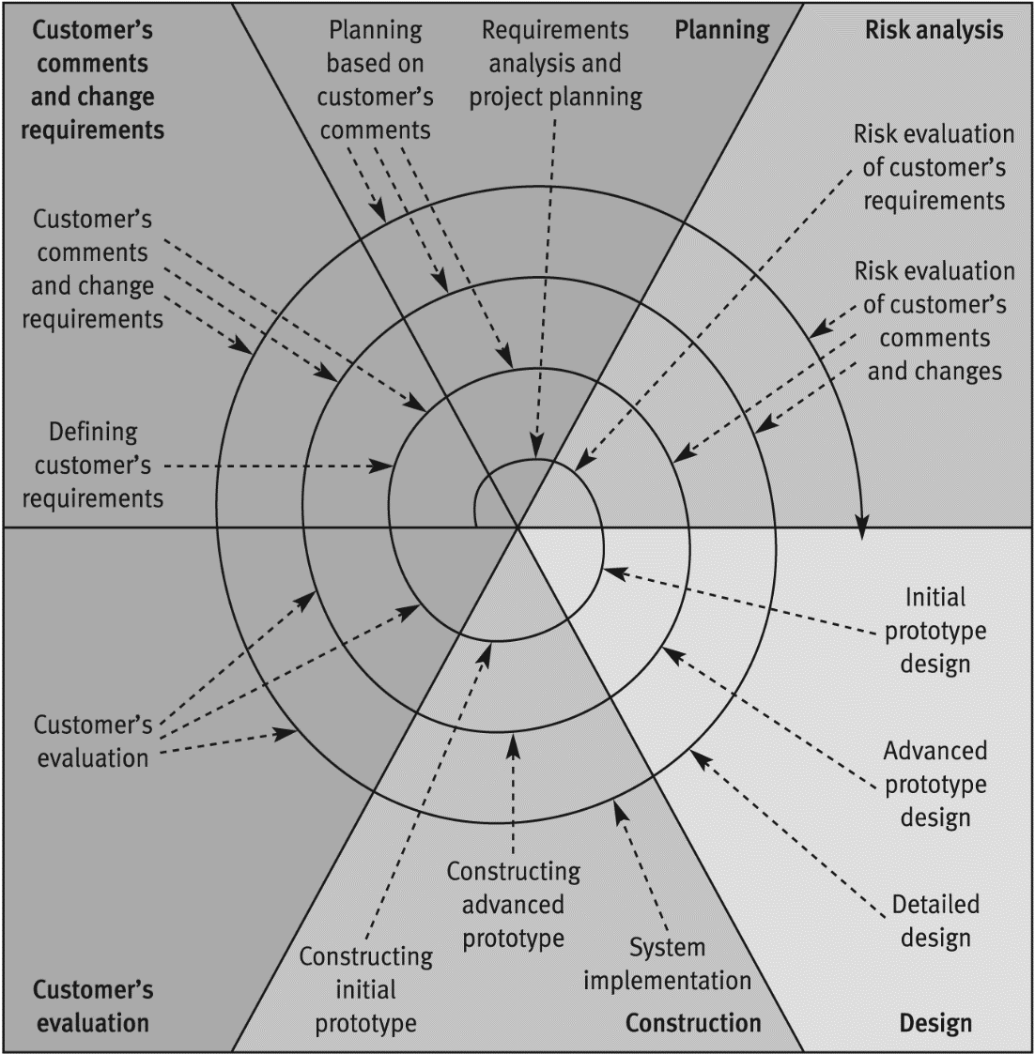
The Advanced Spiral Model: The Win-Win Spiral Model
Revised Spiral Model provides
customer with improved chances
for changes;
developer better chances to stay
within budget and time.
Done by increased emphasis on
customer participation and
on engineering activities.
Extra sections in spiral
dedicated to customer actions
and developer engineering.

Slide 20
The Spiral Model: Benefits
Provides early indication of unforeseen problems.
As costs increase, risks decrease.
Always addresses the biggest risk first.
Focuses attention on reuse.
Accommodates changes, growth.
Eliminates errors and unattractive choices early.
Limits to how much is enough (not too much design, reqs, etc).
Treats development, maintenance same way.

Slide 21
The Spiral Model: Problems
What are some drawbacks to the spiral model?
Complicated
Relies on developers to have risk-assessment expertise
Possibly more management overhead to assess risk
Need for more elaboration of project steps(clearer milestones)
Matching to contract software (doesn't work well when you're bound to a fixed inflexible contract)

Slide 22
References
Software Engineering, Sommerville, I., Chapter 2 & 3, 10th Edition (2016), Pearson.
Software Engineering: A Practitioner’s Approach, Pressman, R.S. & Maxim B., Chapter 2 & 3, 8th Edition (2015), McGraw-Hill.

